Slide 1
Drone Racing Optimal Control and Trajectory Estimation
Antoni Rosinol

Slide 2
Motivation

Slide 3
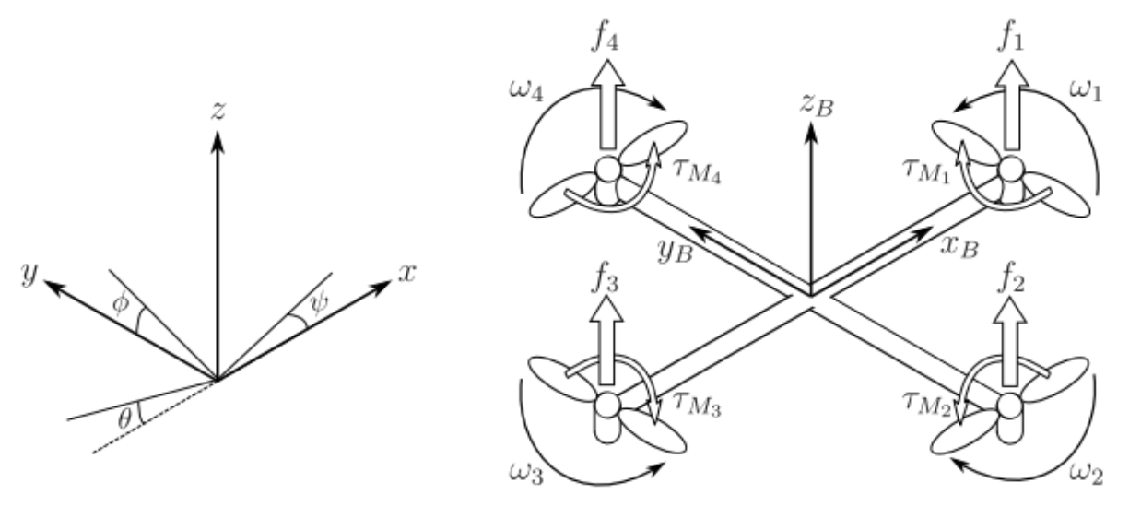
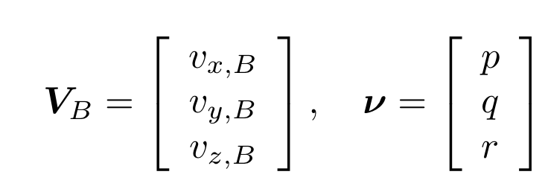
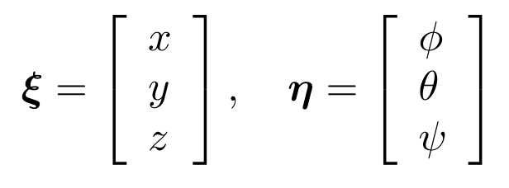
Drone Dynamics
Absolute Position
Absolute Orientation
Linear Velocities
Angular Rates

Slide 4
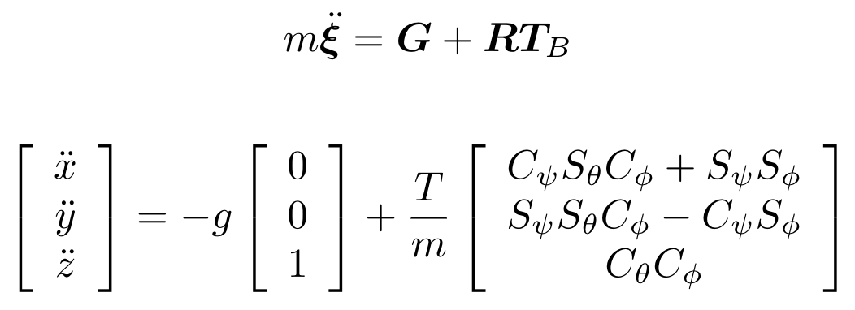
Drone Dynamics
Newton’s Second Law:

Slide 5
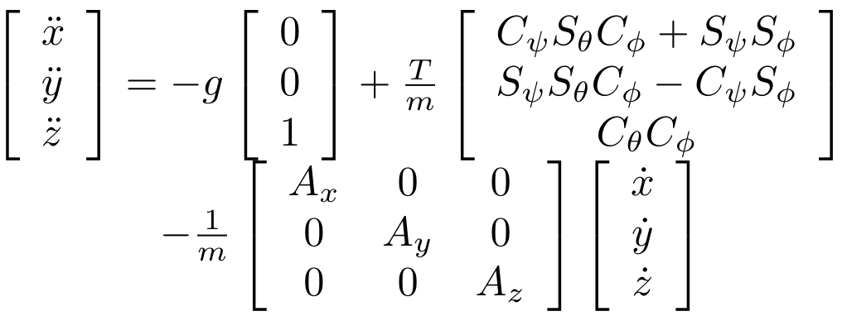
Drone Dynamics
Considering Aerodynamic Drag:

Slide 6
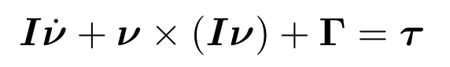
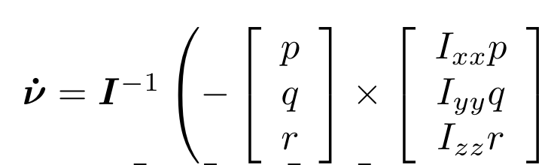
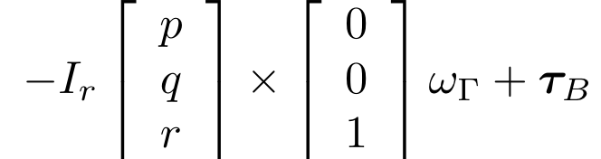
Drone Dynamics
Euler’s Second Law:

Slide 7
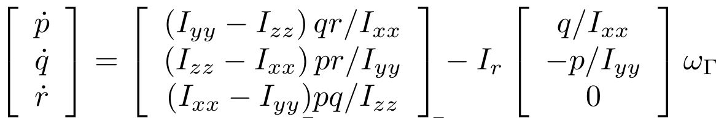
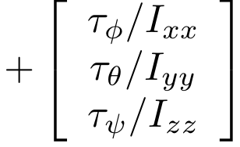
Drone Dynamics
Euler’s Second Law:

Slide 8
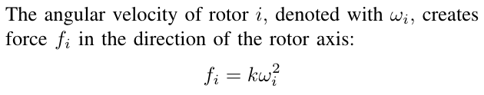
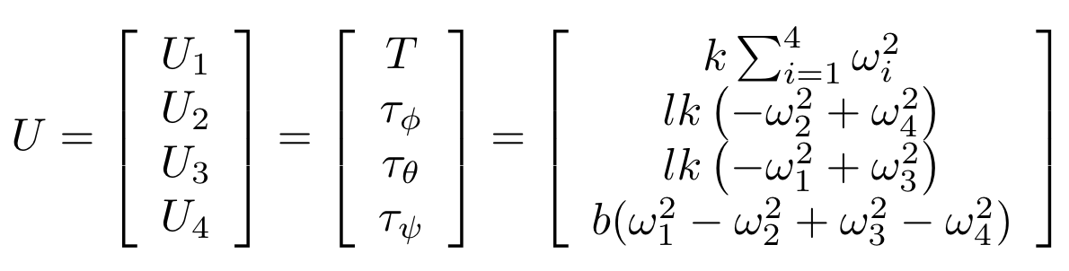
Control Inputs

Slide 9
Drone Dynamics
State:
Control:

Slide 10
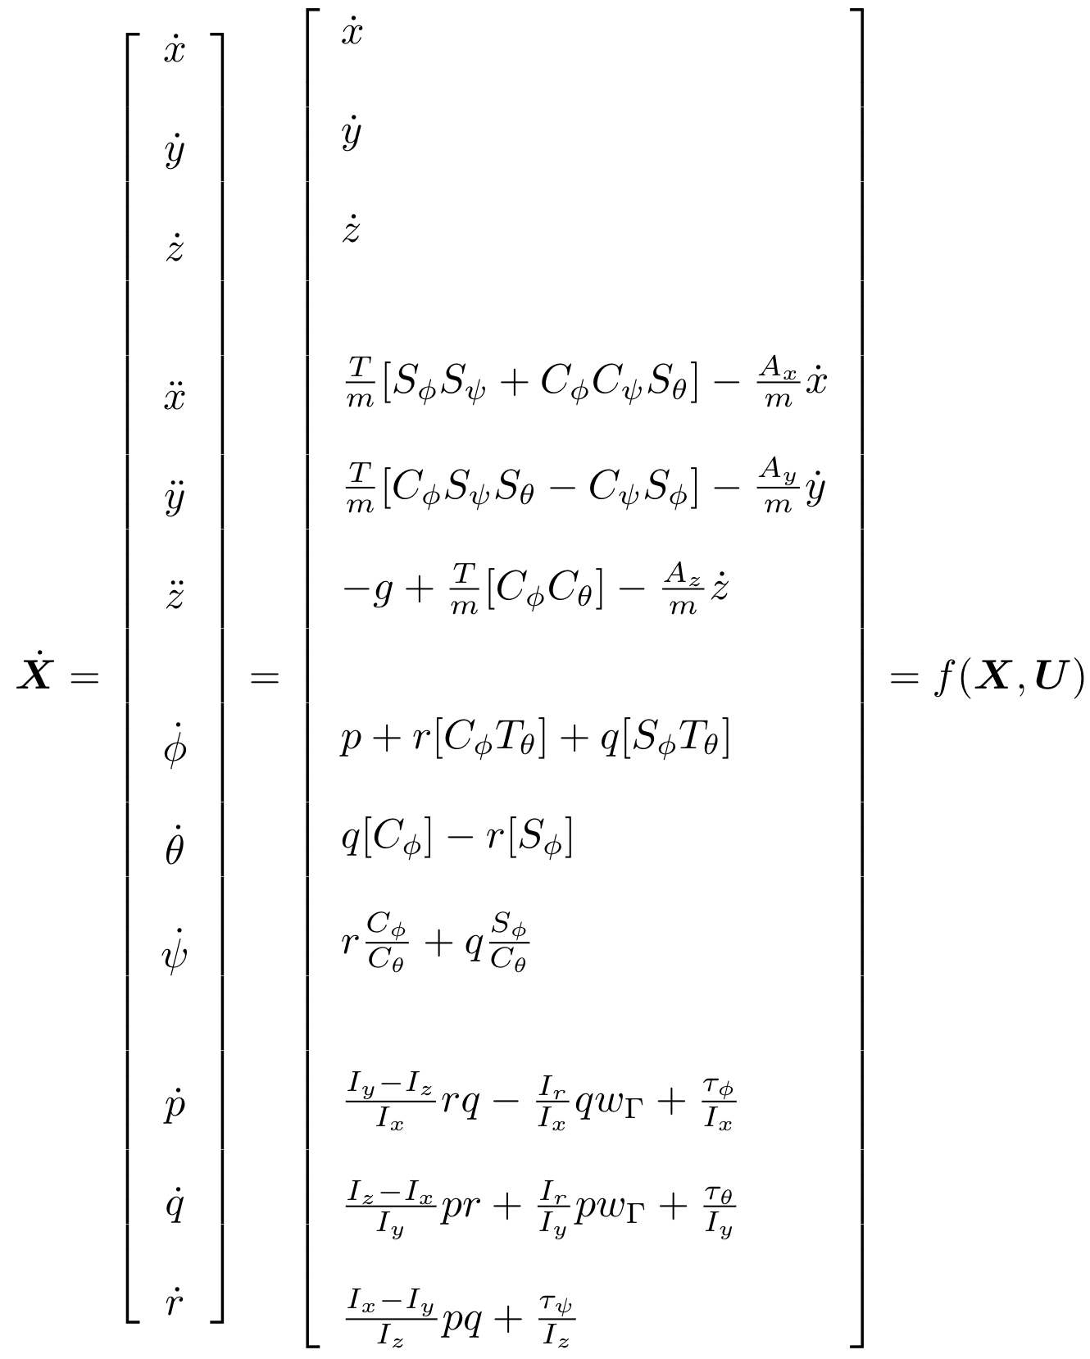
State-Space Dynamics

Slide 11
State-Space Dynamics

Slide 12
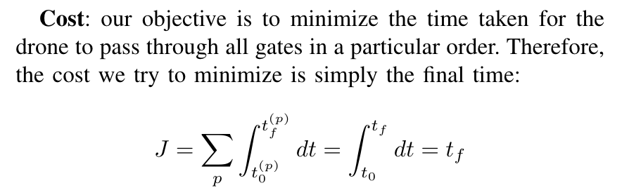
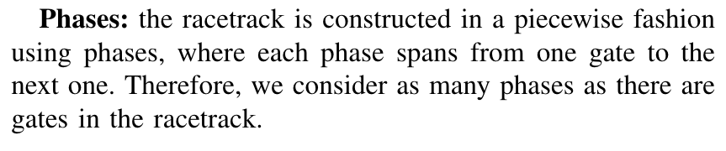
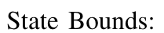
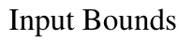
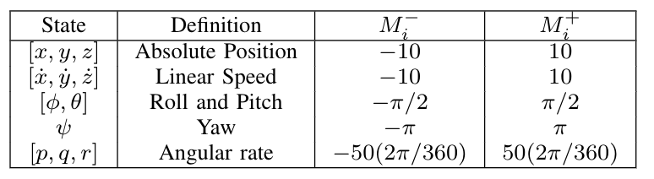
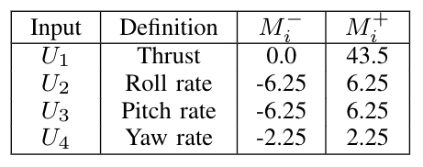
Minimum Time Optimal Control Problem

Slide 13
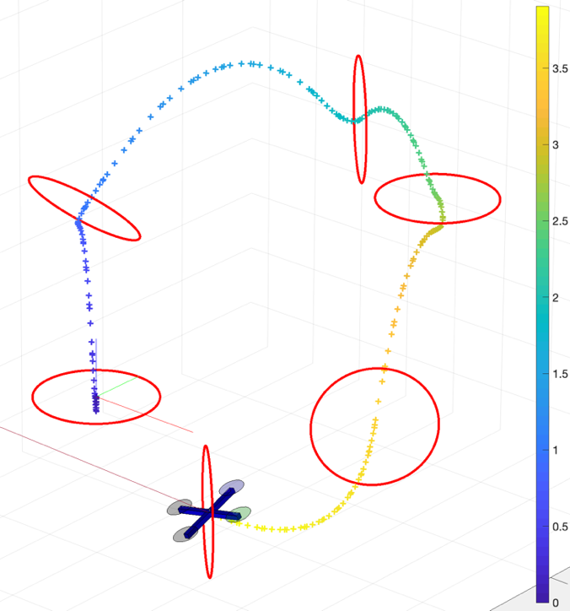
Drone Racing

Slide 14
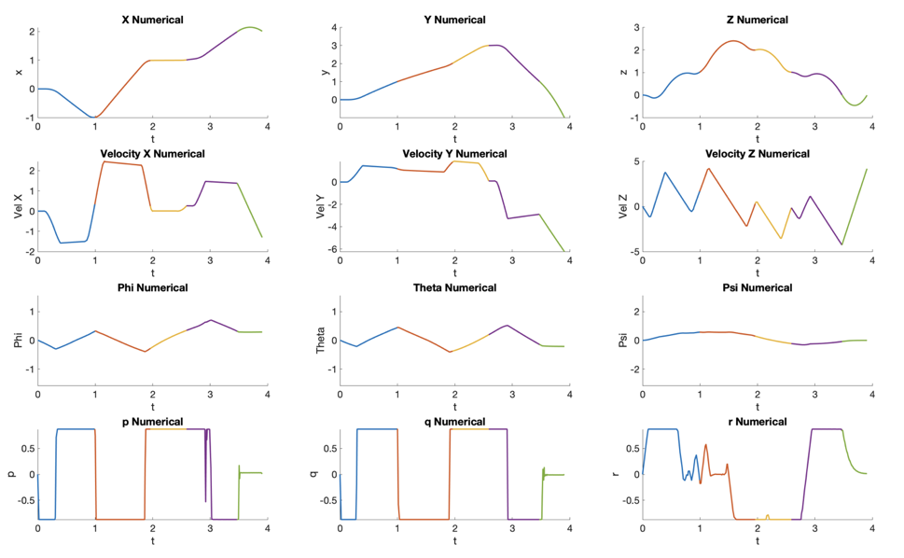
Optimal State (trajectory)

Slide 15
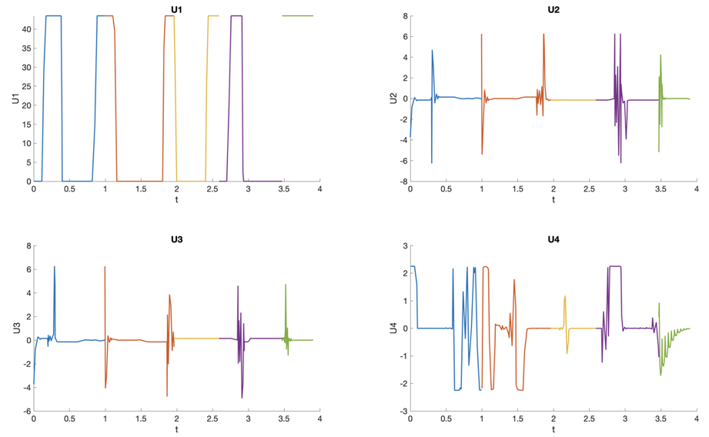
Optimal Controls
Roll Rate
Thrust
Pitch Rate
Yaw Rate

Slide 16
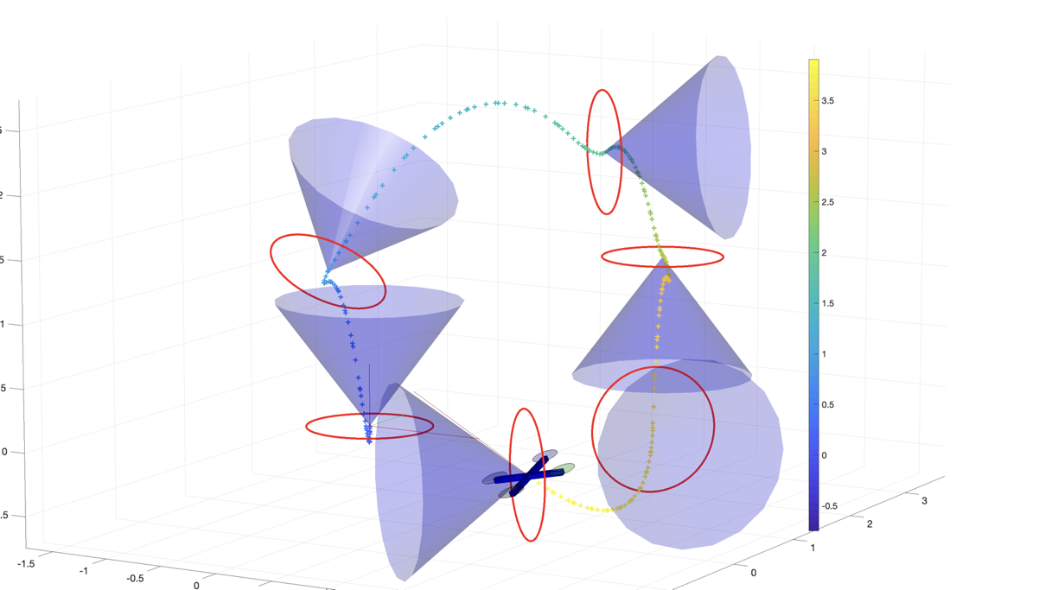
Conic Constraints for Gate Traversal

Slide 17
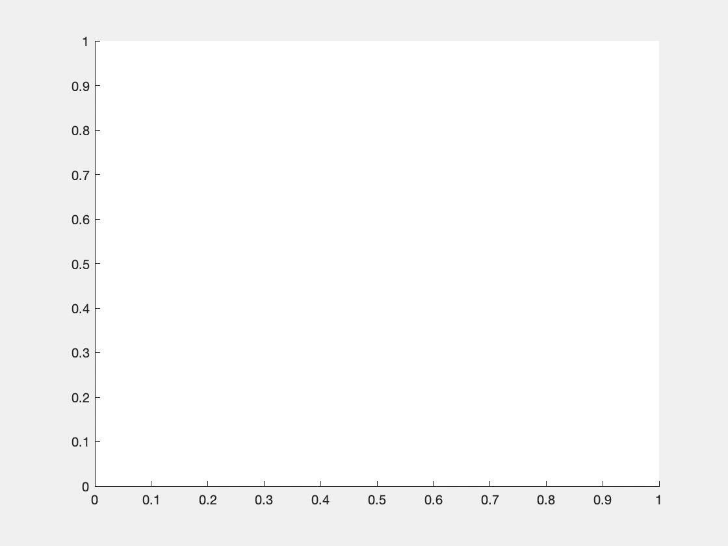
Conic Constraints for Gate Traversal

Slide 18
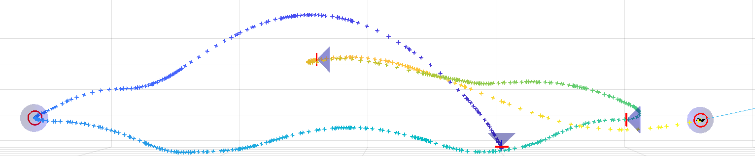

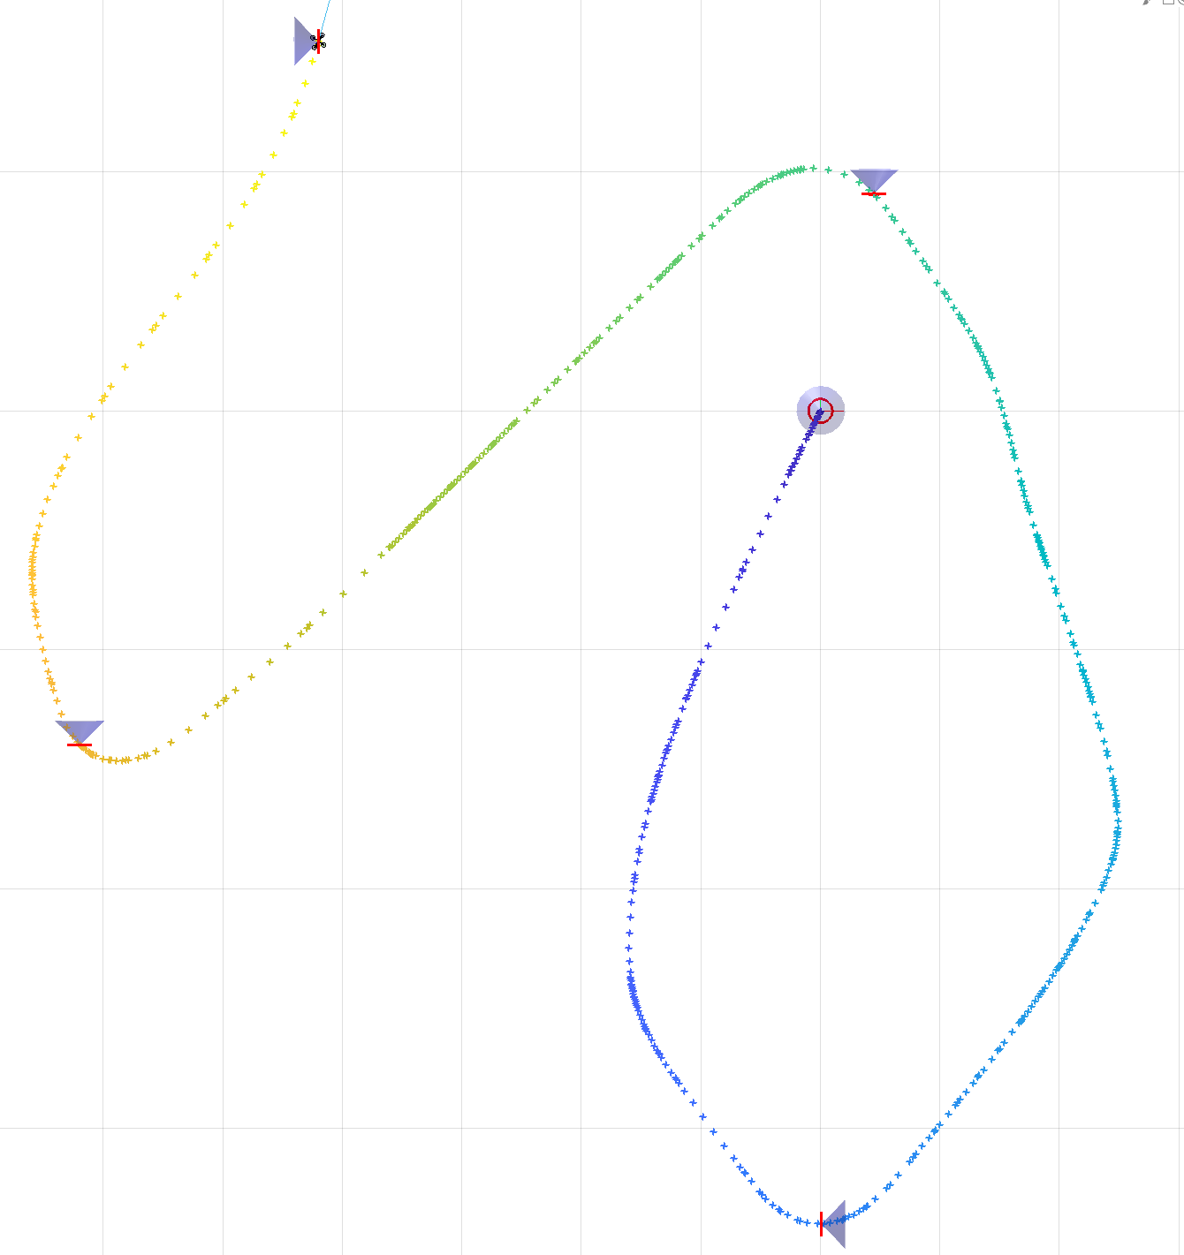
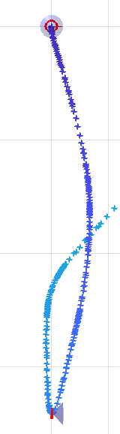
Drone Race
Y-Z View
… wo conic constraints
X-Y View

Slide 19
Drone Race
The real race…
Give me a second while I look for it, thanks!

Slide 20
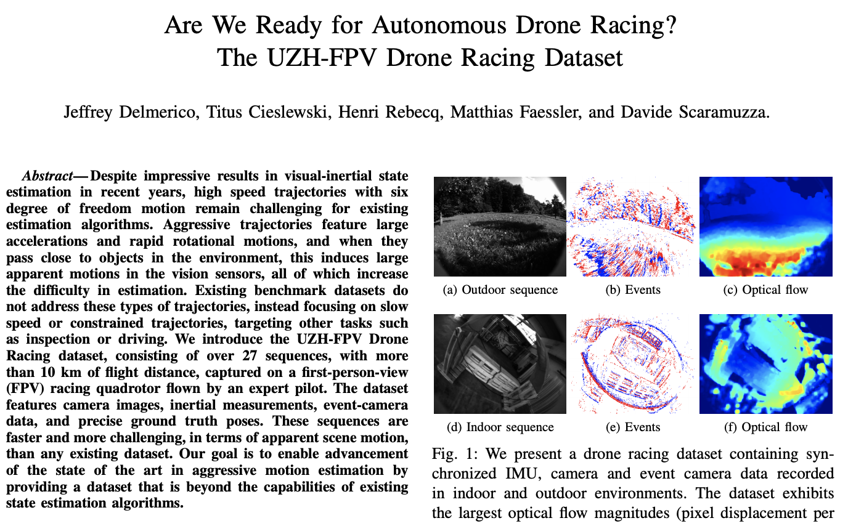
Conclusion

Slide 21
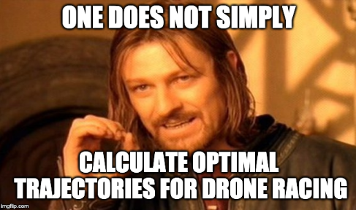
Conclusion

